Slide 1
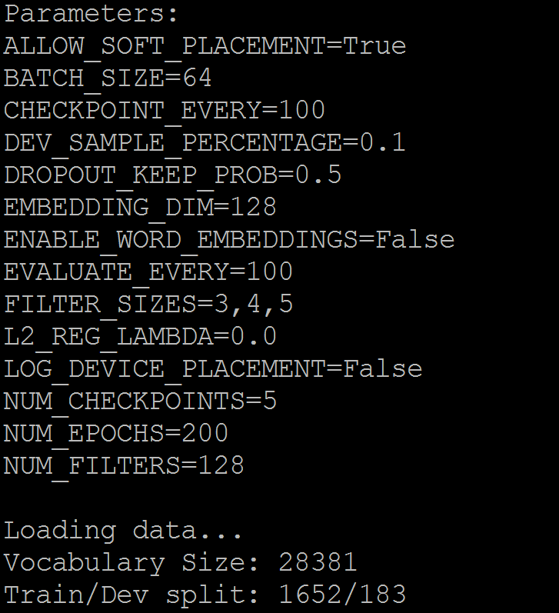
Parameters

Slide 2
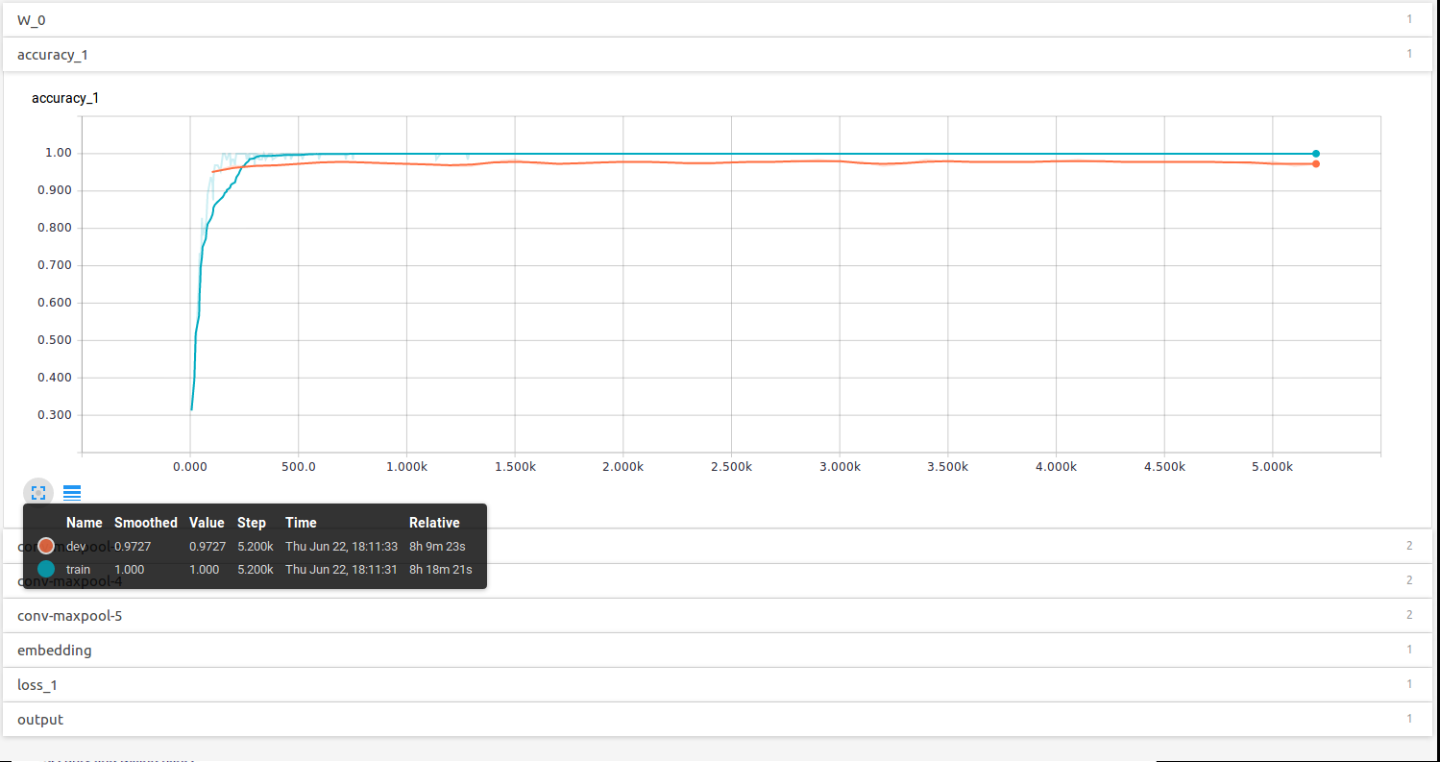
Using pre-trained Word2Vector for word embedding

Slide 3
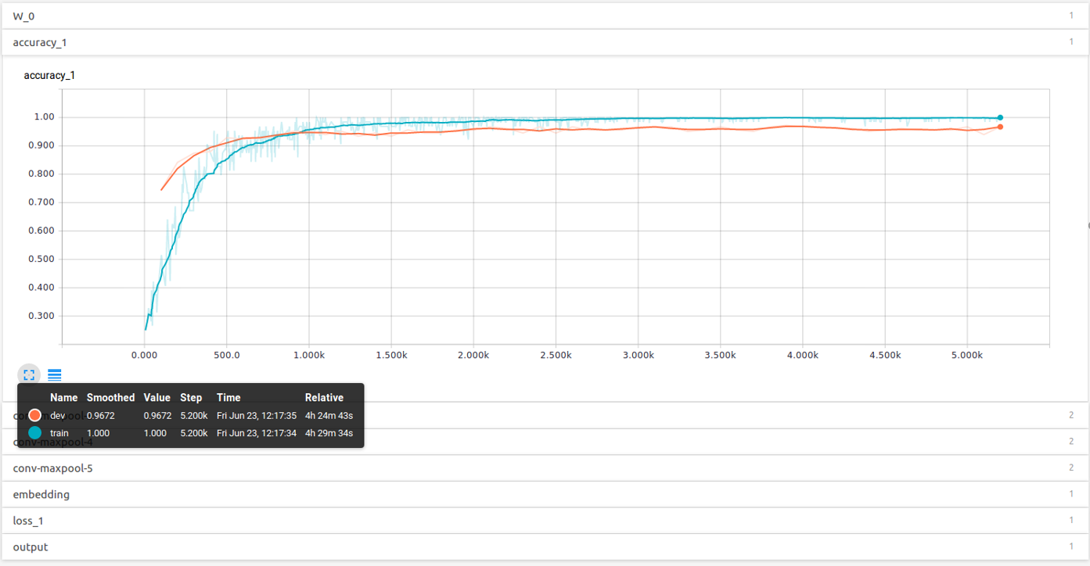
Learn embeddings from scratch

Slide 4
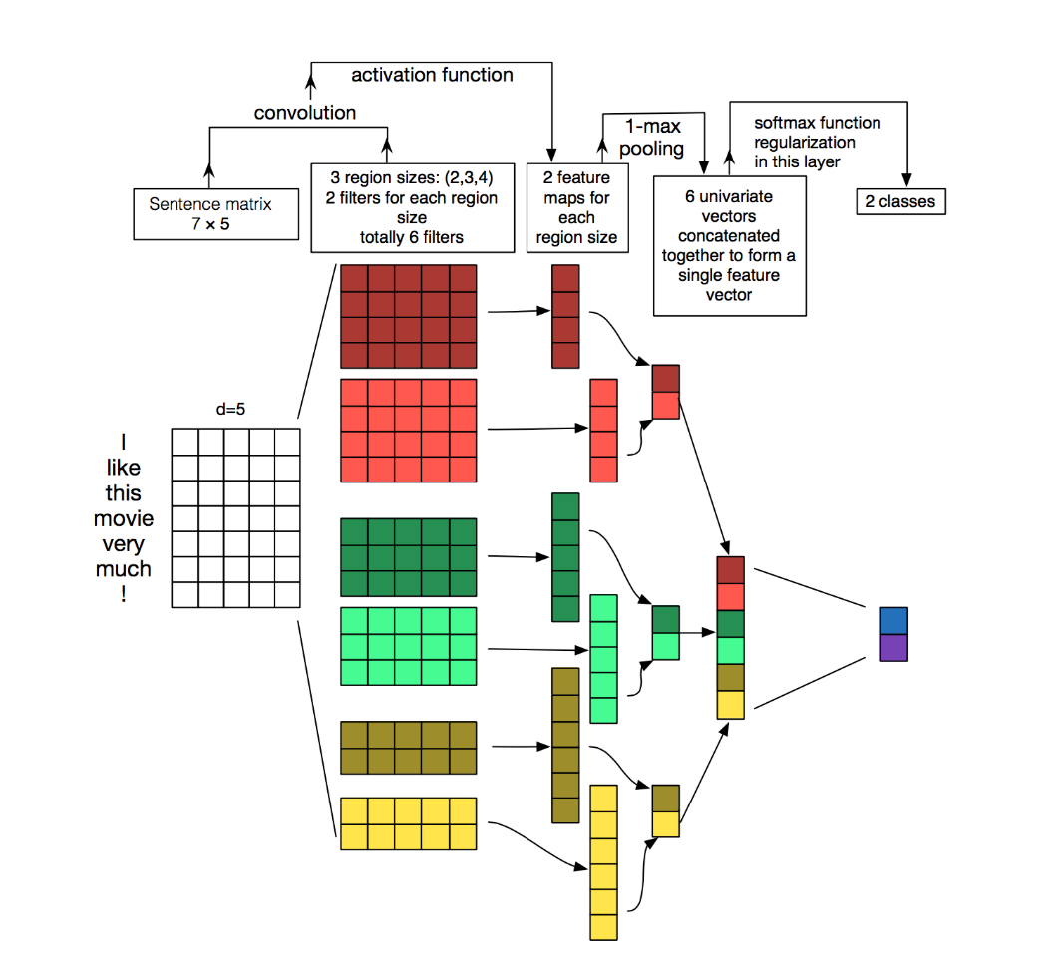
Example

Slide 5
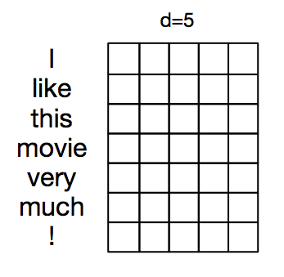
Articles Representation
Each row of the matrix corresponds to one token(word)
Each row is vector that represents a word. Typically, these vectors are word embedding
For our data d = 300 (pre-trained Google News corpus word vector model

Slide 6
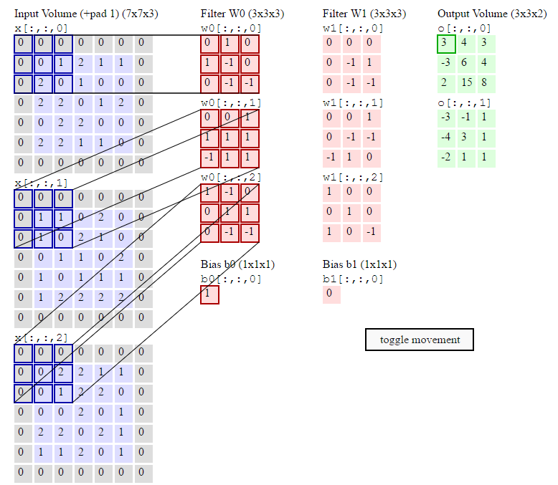
Convolutional Neural Networks
filters slide over local patches of an image
NLP we typically use filters that slide over full rows of the matrix (words).
The height, or region size, may vary, but sliding windows over 2-5 words at a time is typical.
Animation of the sliding window:

Slide 7
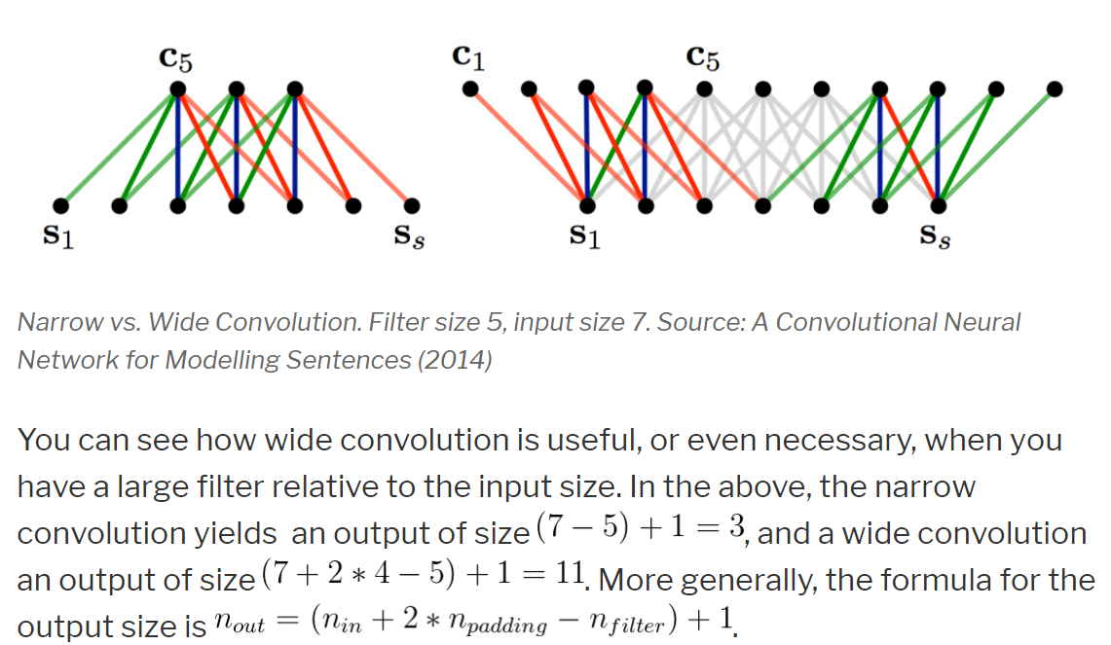
Narrow vs. Wide convolution

Slide 8
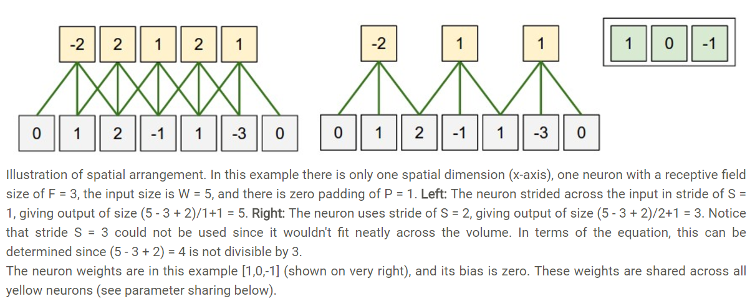
Stride size

Slide 9
Parameters
D: Depth, number of filters
S: Stride, move the filters how many pixels at a time
P: Zero-padding, zeros around the boarder
W: input volume size
O = (W-F + 2P)/S +1

Slide 10
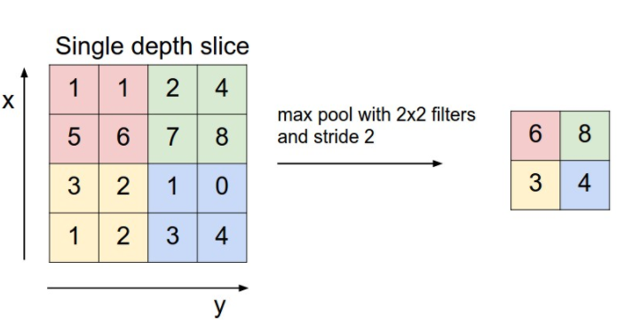
Max pooling

Slide 11
BBC News data architecture

Slide 12
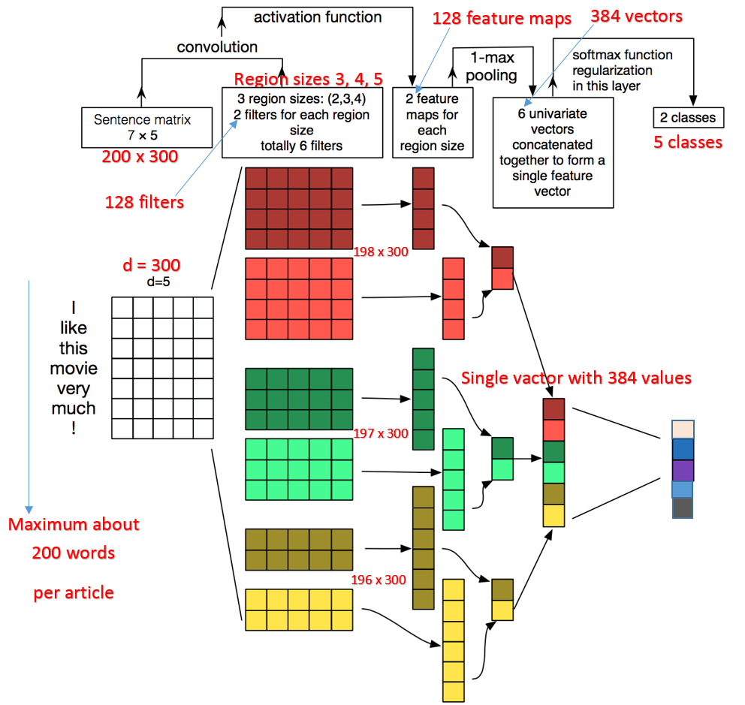
BBC news architecture

Slide 13
Next is for DBN embedding test

Slide 14
Embedding comparing
Categories | Glove | DBN
business.txt | 2189 | 2189
enter.txt | 856 | 856
politics.txt | 1073 | 1073
sport.txt | 2160 | 2160
tech.txt | 676 | 676
total | 6954 | 6954
Document length | 40-400 | 15
Total Words | 1,765,293 | 104,310 | 17/1
Unique words | 46116 (2.6%) | 78626 (75%) | 1/1.7

Slide 15
Cross validation Training Result
Glove | Training | 1 | 1 | 1 | 1 | 1 | 1 | 1 | 1 | 1 | 1 | 1
 | Test | 0.93 | 0.93 | 0.93 | 0.93 | 0.93 | 0.93 | 0.92 | 0.93 | 0.93 | 0.93 | 0.929
 |  | 1 | 2 | 3 | 4 | 5 | 6 | 7 | 8 | 9 | 10 | Ave
DBN | Training | 1 | 1 | 0.98 | 0.98 | 1 | 0.96 | 0.94 | 1 | 1 | 1 | 0.986
 | Test | 0.29 | 0.31 | 0.16 | 0.33 | 0.34 | 0.34 | 0.27 | 0.31 | 0.34 | 0.34 | 0.303

Slide 16
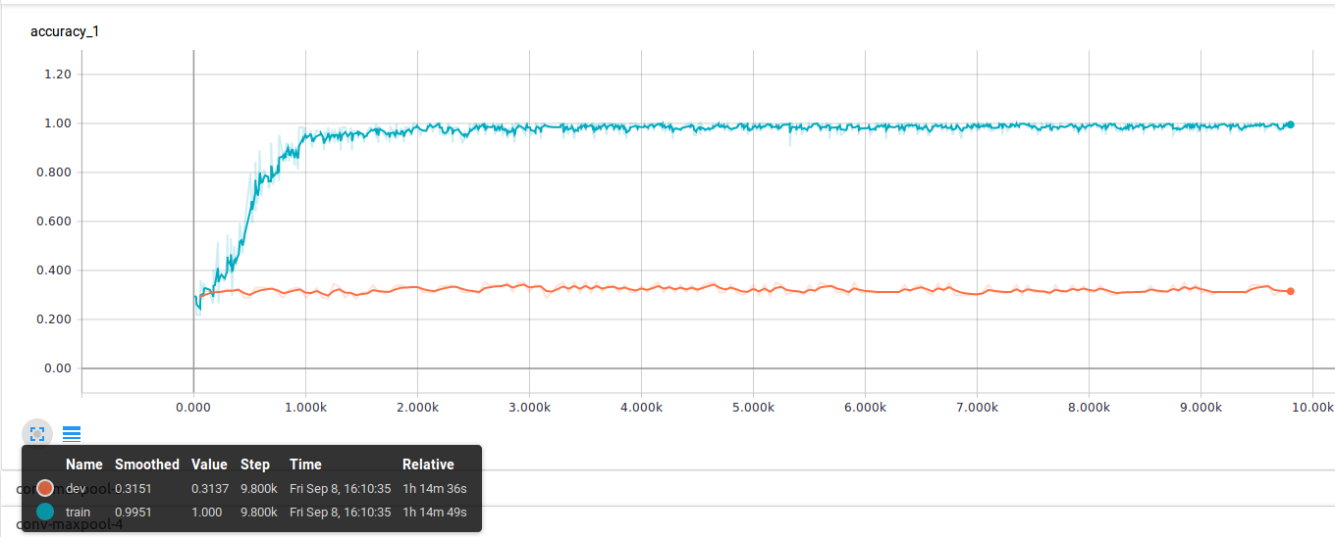
DBN result embedding test

Slide 17
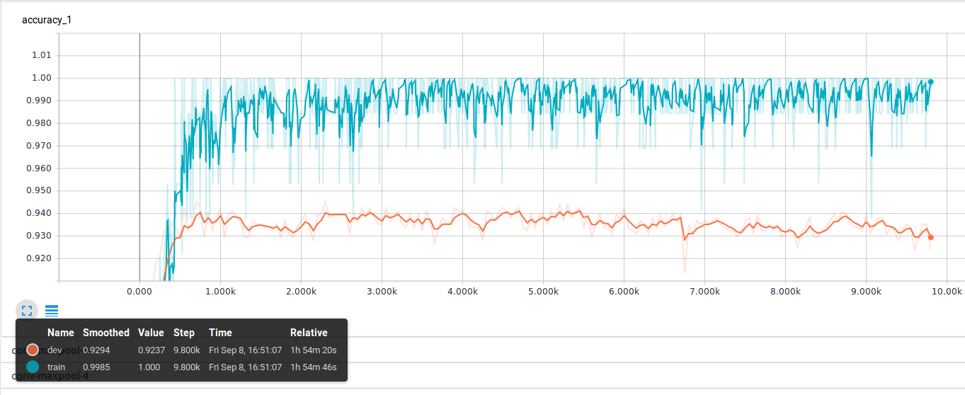
Glove embedding test

Slide 18
DBN test using different vocabulary size
 |  | Train | Dev
DBN test using different vocabulary size | 78626 (75% of total words 104310) | 0.986 | 0.303
 | 8889 (8.5% of total words 104310) | 0.843 | 0.333

Slide 19
DBN test in big vocabulary size
 |  | Train | Dev
DBN test in big vocabulary size(75% of total words 104310) | dbn embedding | 0.986 | 0.303
 | non embedding | 0.98 | 0.23

Slide 20
DBN test in small vocabulary size
 |  | Train | Dev
DBN test in small vocabulary size (8.5% of total words 104310) | dbn embedding | 0.843 | 0.333
 | non embedding | 1 | 0.343

Slide 21
Test results for pre-trained and self-trained word2vector
 | glove-wikipedia-100d | Googlenews-300d | self-trained-25d
All 6000 news data | 0.981 | 0.983 | 0.936

Slide 22
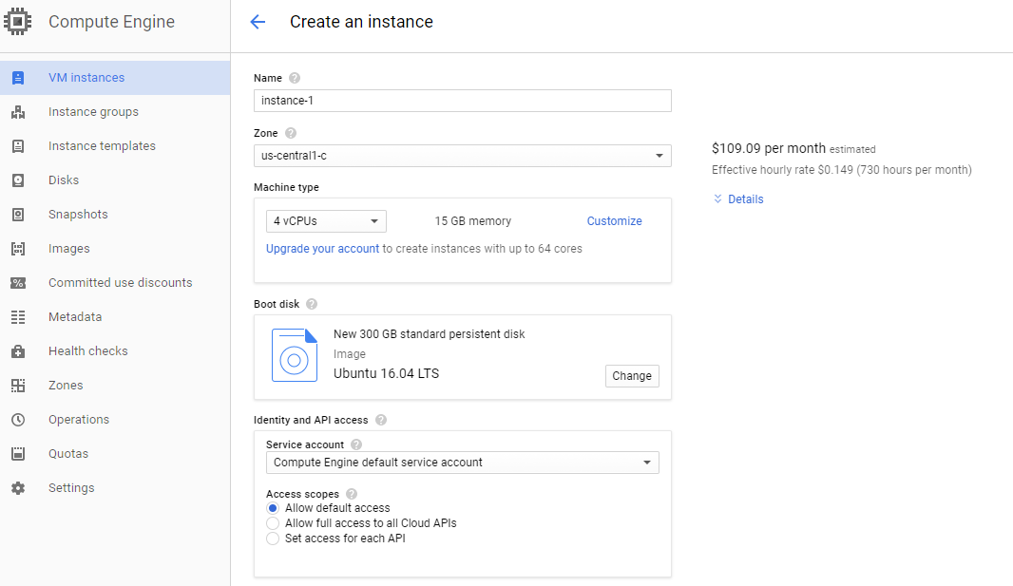
Google Could Cost estimate 4-vCPU, 15G-Mem, 300G-disk $109/Mon

Slide 23
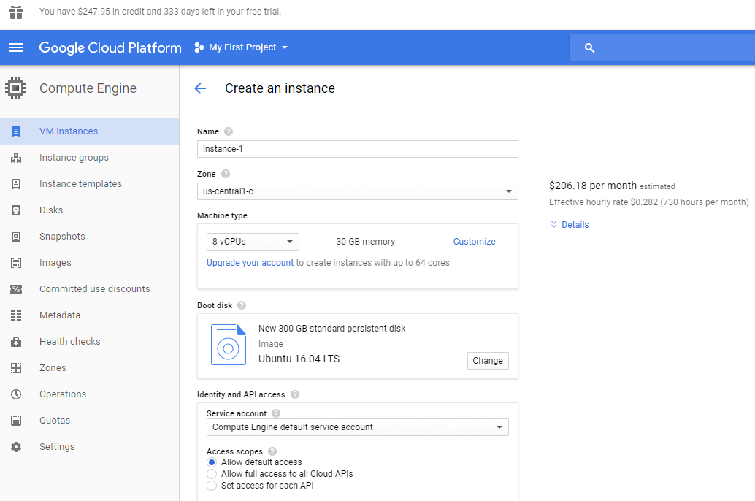
Google Could Cost estimate 8-vCPU, 30G-Mem, 300G-disk $206/Mon

Slide 24
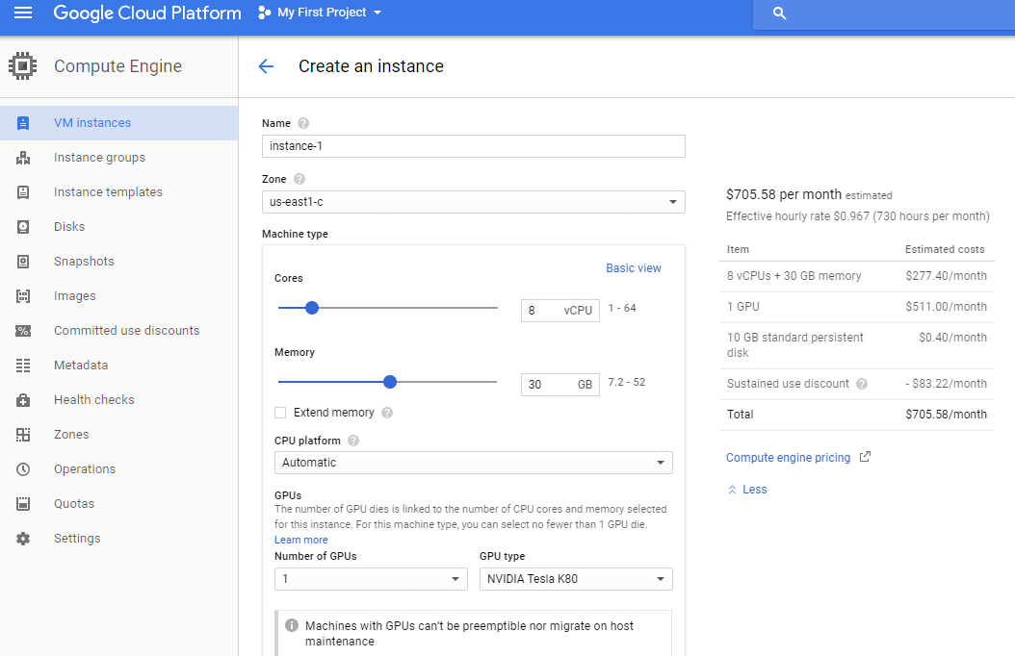
Google Could Cost estimate 8-vCPU, 30G-Mem, 1-GPU $706/Mon

Slide 25
Comparing of different prob rate
Comparing of different prob rate
 | prob0.5 | prob0.4 | prob0.3 | prob0.2 | prob0.1 | Diff
training | 0.986 | 0.985 | 0.978 | 0.959 | 0.927 | 0.013
test | 0.931 | 0.919 | 0.914 | 0.921 | 0.914
Origin parameters: prob = 0.5 filters = 128 window_size = 3, 4, 5

Slide 26
Comparing of different number of filters
Comparing of different number of filters
 | filters_128 | filters_80 | filters_64 | filters_32 | filters_16 | Diff
training | 0.986 | 0.985 | 0.98 | 0.973 | 0.957 | 0.037
test | 0.931 | 0.931 | 0.92 | 0.922 | 0.92
Origin parameters: prob = 0.5 filters = 128 window_size = 3, 4, 5

Slide 27
Comparing of different window size
Comparing of different window size
 | win345 | win34 | win45 | win5 | win4 | win3 | Diff
training | 0.986 | 0.984 | 0.987 | 0.983 | 0.977 | 0.977 | 0.047
test | 0.931 | 0.917 | 0.921 | 0.925 | 0.921 | 0.93
Origin parameters: prob = 0.5 filters = 128 window_size = 3, 4, 5

Slide 28
Final test with filters_80 win34 prob0.2
Origin parameters: prob = 0.5 filters = 128 window_size = 3, 4, 5
Final test with filters_80 win34 prob0.2
training | 0.941 | 0.027
test | 0.914

